Slide 1
QA Cinema Project
By Shameer Dar, Haaris Moghal, Oliver dillon and Andrew McCall

Slide 2
Introduction
Created a Full stack MERN application, with utilization of supporting tools and methodologies, covered during training.
Create a web application following the Enterprise Architecture Model, using:
Presentation layer - A front-end written using React
Business Layer - An expressJS API
Data Layer – A Mongo database

Slide 3
Project Approach
Project objective:
To create a functional Full Stack MERN application
Focused on the MVP (Minimum Viable Product)
Project breakdown:
Project Management platform – Jira-Kanban Board
Key deliverables were split into user stories.
Component Hierarchy and ERD diagrams
CRUD back-end
Fully integrated front end
Testing : JEST, Chai and Mocha
Styling
Git management

Slide 4
Team Roles
Scrum Master:
Oliver Dillon
Product Owner:
Shameer Dar
Development Team:
Frontend Developers – Shameer Dar & Haaris Moghal
Backend Developers – Oliver Dillon & Andrew McCall

Slide 5
Consultant Journey
Version Control System:Git, Github.
MERN Stack
Testing –Mocha, Chai and JEST
Project Management platform – Jira/Kanban board
Postman

Slide 6
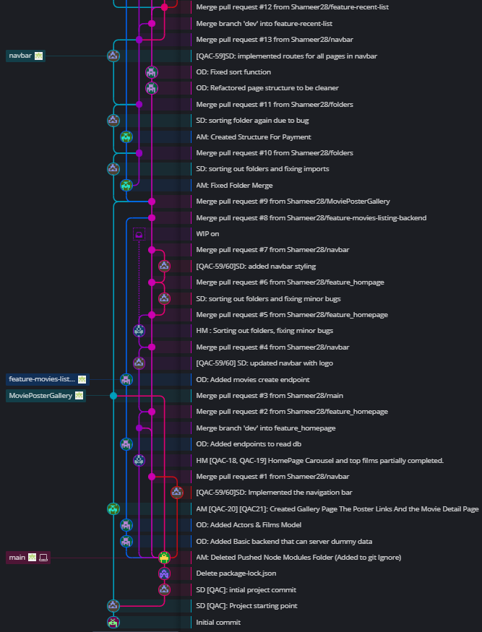
Continuous Integration
Feature-branch model. (GitKraken)
Regular commits to ensure project safety.

Slide 7
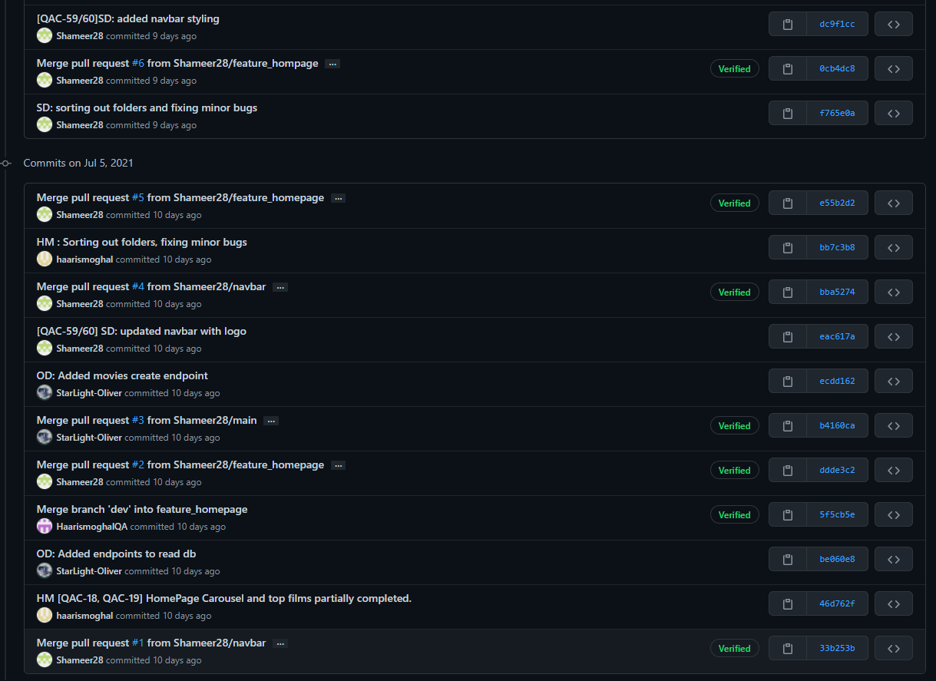
Continuous Integration
Added Jira Tags
On relevant
commits

Slide 8
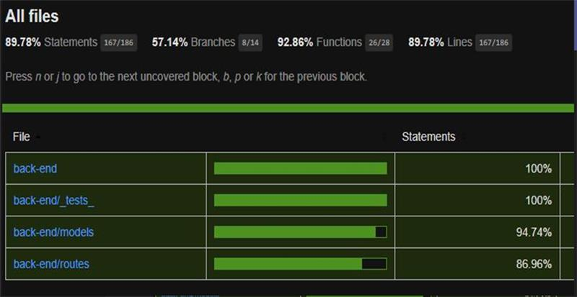
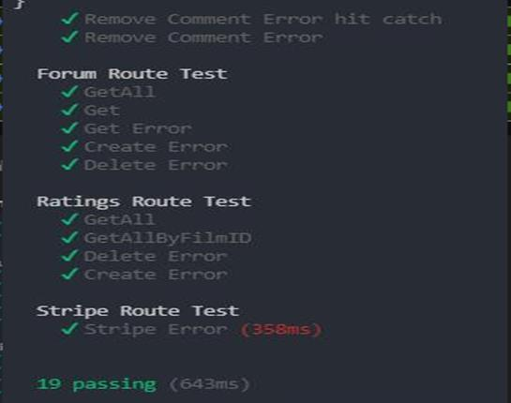
Backend Testing – Chai & Mocha
Managed to get 89.78% test coverage on the backend.
Chai how the test is run and Mocha was the test environment used.

Slide 9
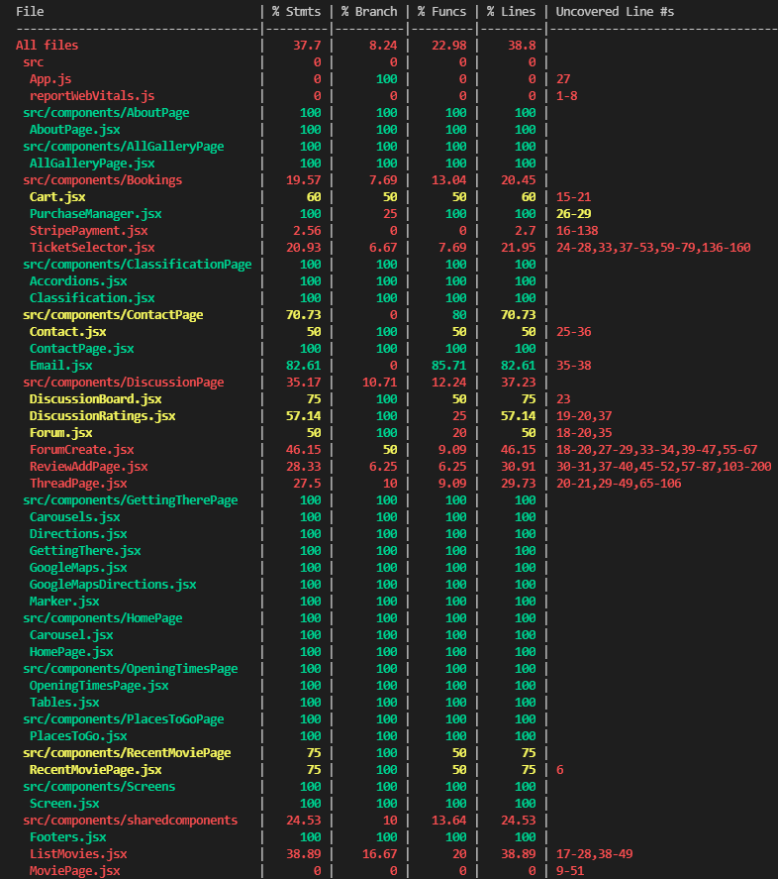
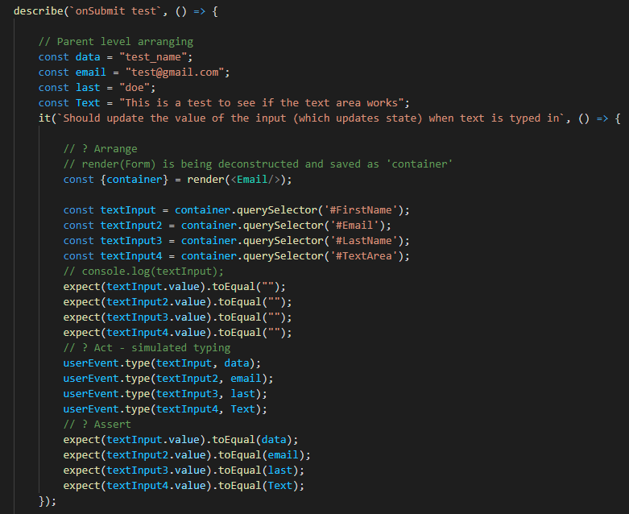
Frontend Testing - JEST
Jest is a JavaScript Testing Framework with a focus on simplicity.
Code Coverage: Generate code coverage

Slide 10
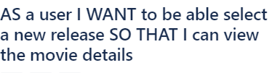

Demonstration
Demonstration of the project

Slide 11
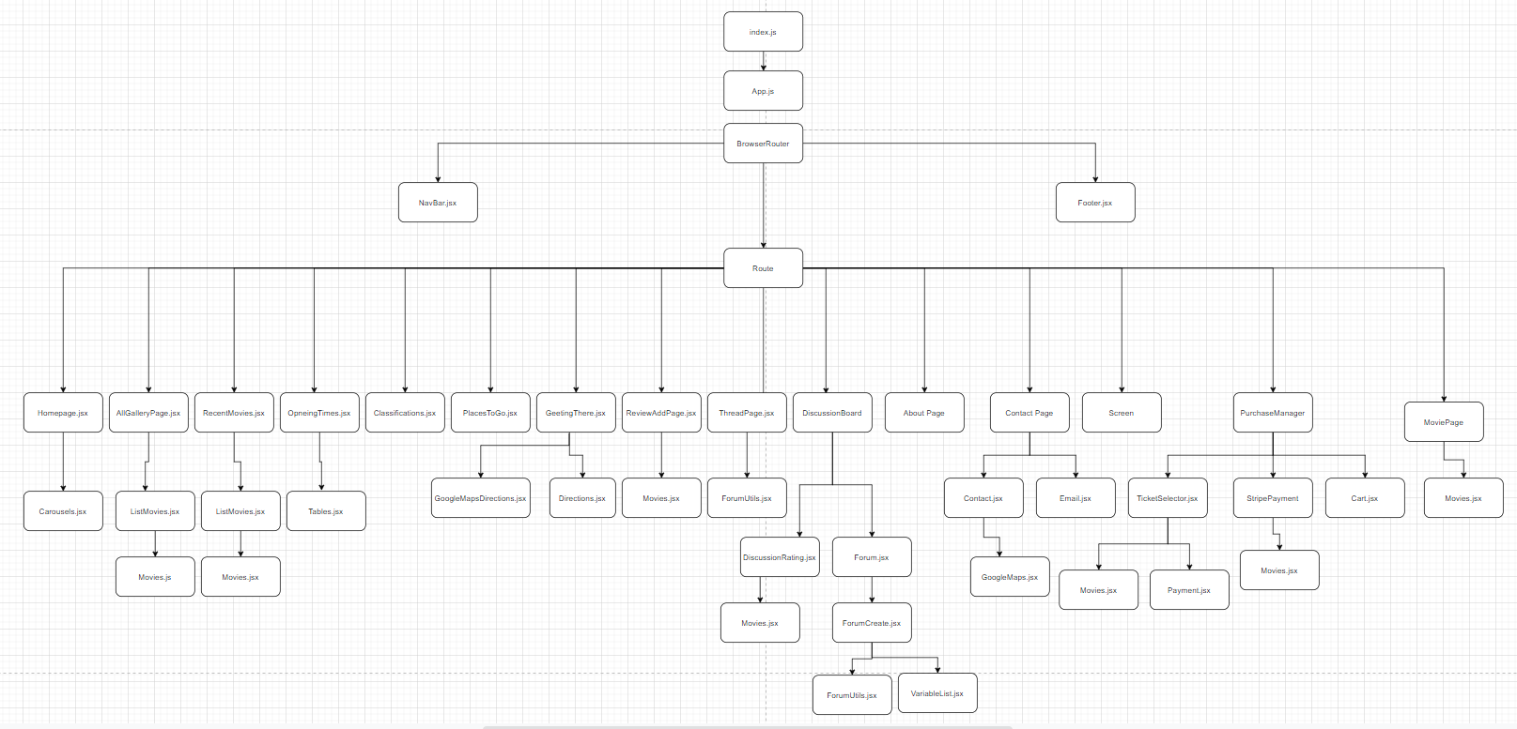
Component Hierarchy

Slide 12
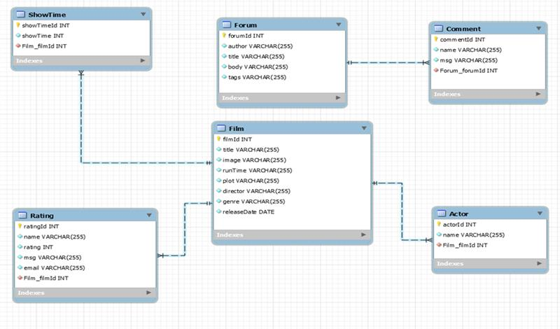
ERD – Entity Relationship Diagram

Slide 13
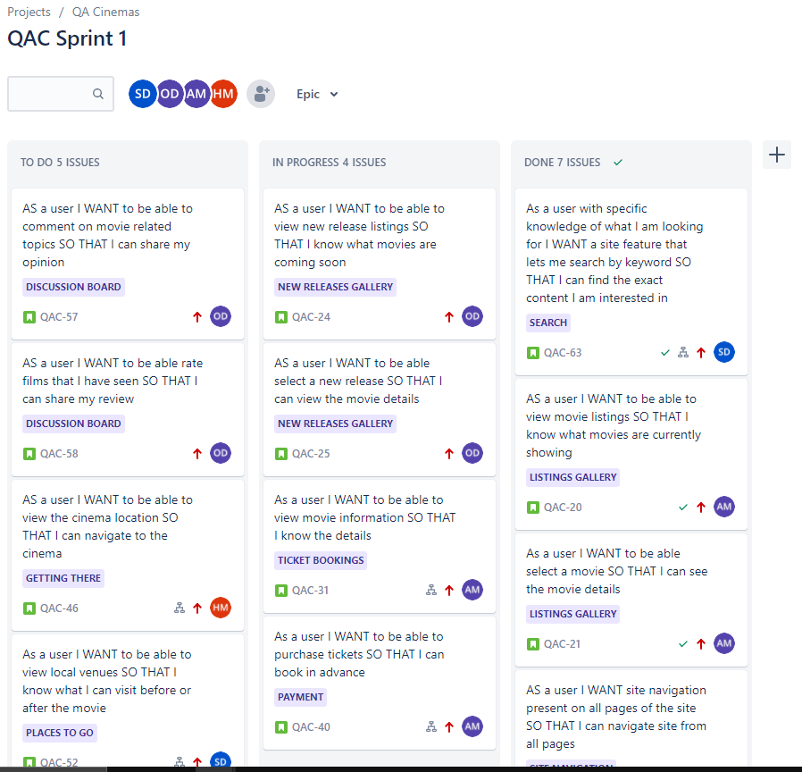
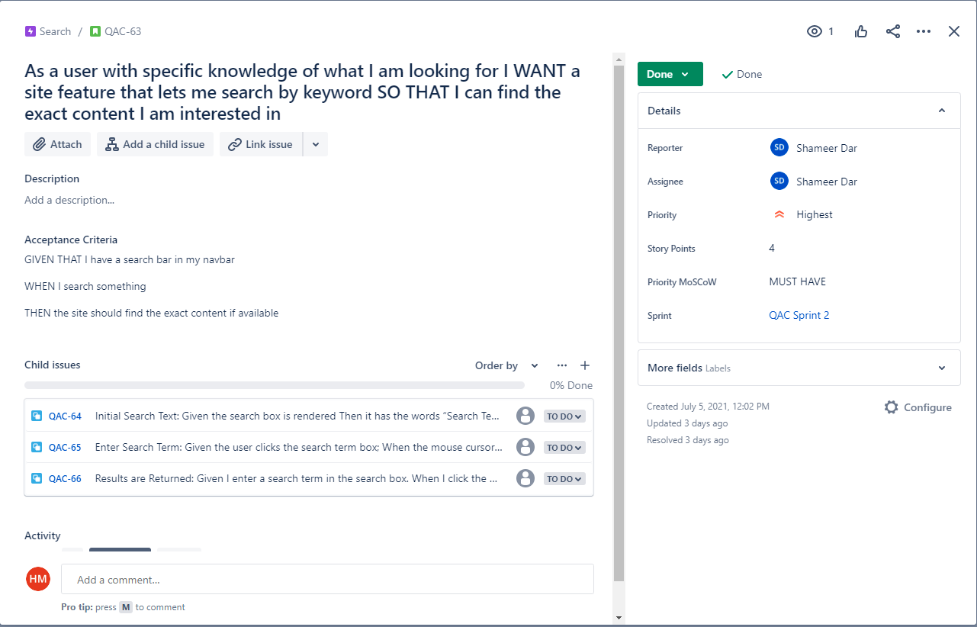
Jira – Kanban Board Week 1
Example of one the user stories.

Slide 14
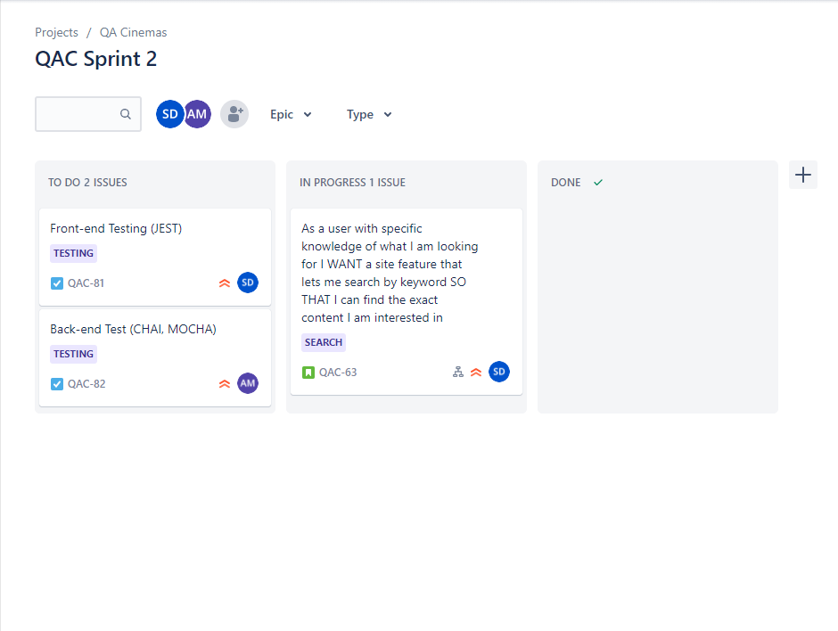
Jira – Kanban Board Week 2

Slide 15
Sprint review
Managed to complete the main functionality required according the deliverables:
CRUD functionality on the Back-end
Testing >80%
What got left behind:
All MVP has been met, nothing was left behind.

Slide 16
Sprint retrospective
What went well?
All the user requirements were completed
Version Control
Good initial understanding of testing (JEST, Chai, Mocha)
Good use of resources, understanding the strengths and weaknesses of each developer.
Improvements?
More continuous testing, test after completing the component
Realistic backlogs

Slide 17
Conclusion
This sprint has improved our knowledge:
Front end calls to backend
Testing : Mocha, Chai, JEST
MVP met:
Crud functionality
Testing
Using a database
Improvements?
More realistic goals of each sprints

Slide 18
Thank you for listening!

